Slide 1
CAPSTONE PROJECT: FIND THE KEY AREAS TO DO BUSINESS IN BANGALORE, INDIA.

Slide 2
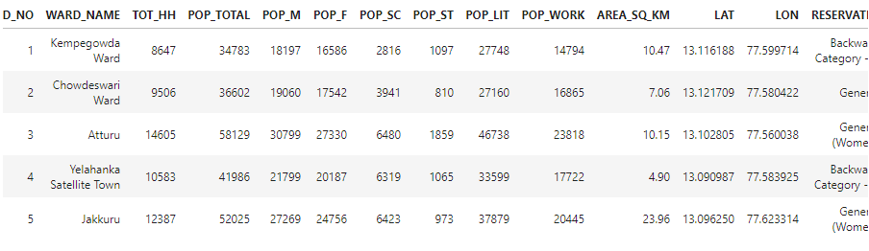
CENSUS DATA
https://raw.githubusercontent.com/suvajit/opendata/master/BBMP/data/CSV/BBMPwards.csv
Top 5 rows only

Slide 3
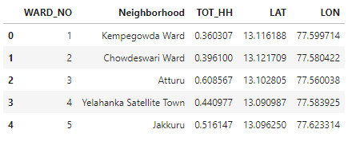
Data wrangling
Top 5 rows only

Slide 4
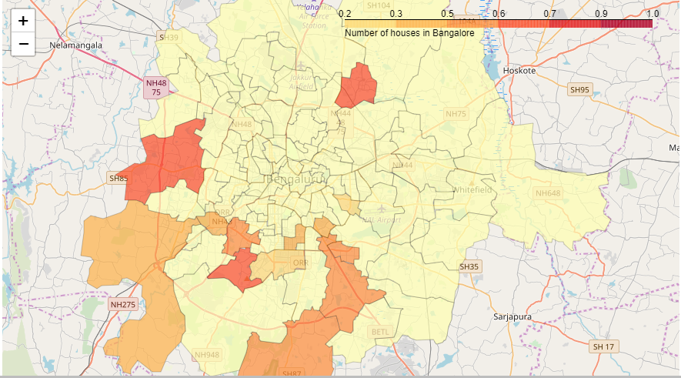
Plotting with data we have now

Slide 5
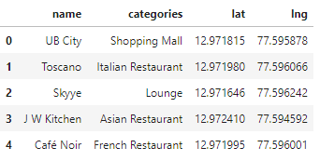
Data got from Foursquare API
Top 5 rows only

Slide 6
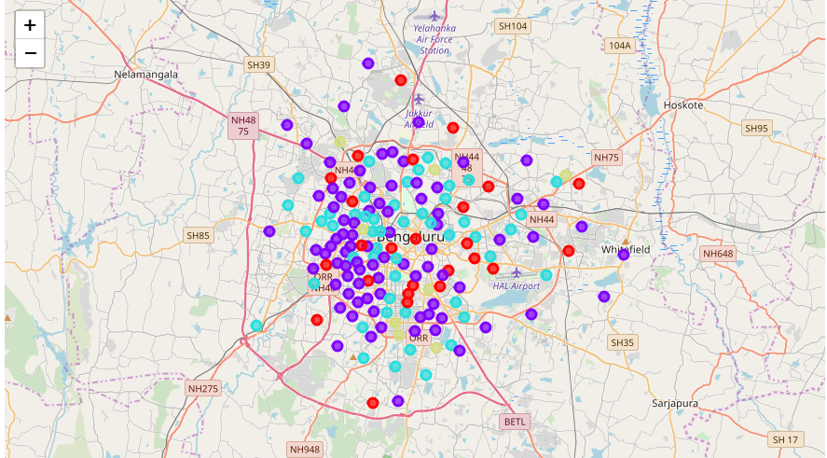
After Clustering

Slide 7
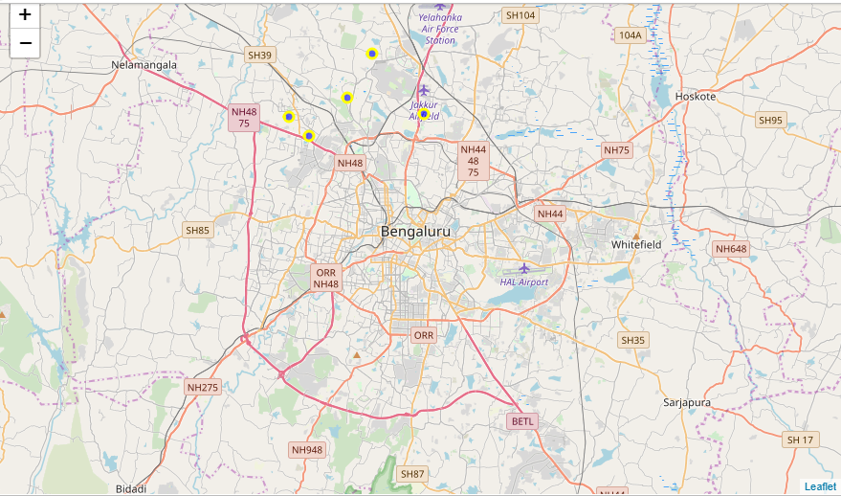
BEST AREAS

